Slide 1


MEDICAL ROBOTICS PROJECT
Surgical Workflow
Analysis
Temporal phase recognition on Cholec80
Christian Corvino
Giorgia Chiaro
Marta Cudia
Alessio Olivieri
Sapienza University of Rome
20 July 2026 · 01
Notes:
Speaker: Christian | Target: 0:20. Good afternoon. We are Christian Corvino, Giorgia Chiaro, Marta Cudia, and Alessio Olivieri. Our project asks a simple but demanding question: can a model understand where a surgical procedure is in time, not just what is visible in a single frame? We evaluate that question on laparoscopic cholecystectomy videos.

Slide 2

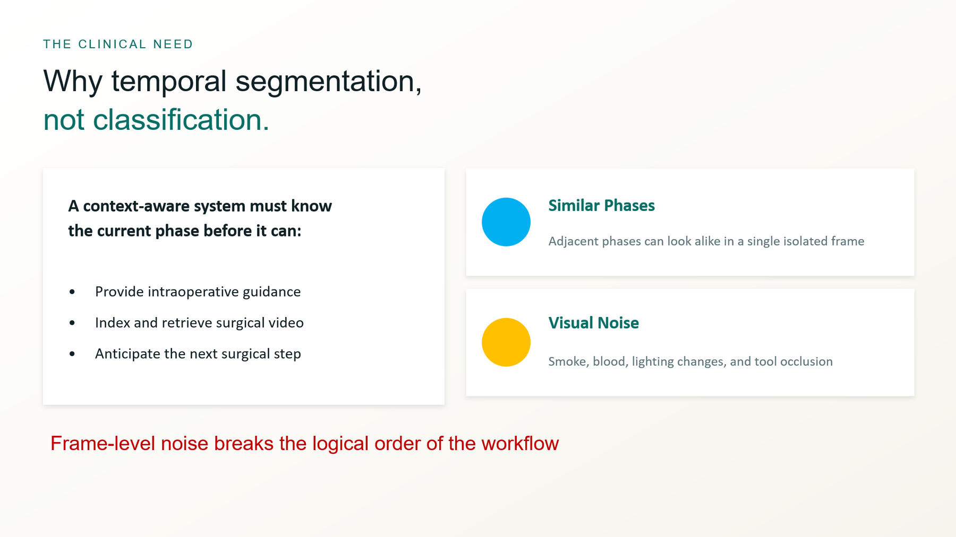
Clinical context: Lalys & Jannin (2014); Padoy (2019); Project report, Chapter 1
Surgical Workflow Analysis
02
Notes:
Speaker: Christian | Target: 0:45. A context-aware surgical system must know the current phase before it can provide useful guidance, index a video, or anticipate what comes next. The difficulty is that adjacent phases can look similar in a single frame, while smoke, blood, lighting changes, and tool occlusion make the visual evidence noisy. A short false transition may barely affect overall accuracy, but it can make the inferred workflow clinically implausible. This is why our problem is temporal segmentation, not ordinary image classification.

Slide 3
DATASET DESIGN
Cholec80 becomes a strict video-level benchmark
80
7
1 fps
184,578
laparoscopic procedures
surgical phases
from 25 fps video
aligned frames
TRAIN · 32 videos
VAL · 8
TEST · 40 videos
No frame-level split: entire videos stay in one partition to prevent leakage.
Source: Project report, Sections 2.2-2.4 · Cholec80 introduced by Twinanda et al. (EndoNet, 2017)
Surgical Workflow Analysis
03
Notes:
Speaker: Christian | Target: 1:05. We use Cholec80, which contains 80 laparoscopic cholecystectomy videos with seven phase labels. The original videos are recorded at 25 frames per second. Because phases last minutes and consecutive frames are highly redundant, we sample one frame per second and resize to 224 by 224. This produces 184,578 labeled frames. Crucially, the split is made by whole video: videos 1 to 32 for training, 33 to 40 for validation, and 41 to 80 for testing. No patient or near-duplicate frame can leak across sets.

Slide 4
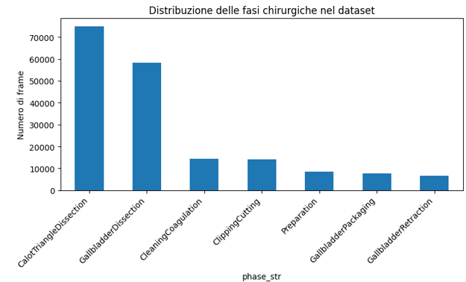
THE DATA CHALLENGE
Real surgical duration creates an 11× class imbalance
72%+
of frames belong to the two dominant dissection phases.
3.6%
of frames represent gallbladder retraction, the rarest class.
Verified
missing opening or closing phases reflect partial recordings, not annotation failure.
Source: Project report, Section 2.5
Surgical Workflow Analysis
04
Notes:
Speaker: Christian | Target: 1:05. The dataset reflects real surgery, so it is strongly imbalanced. Calot triangle dissection and gallbladder dissection together account for more than 72 percent of all frames, while gallbladder retraction is only 3.6 percent. The rarest phase is represented about eleven times less than the most common one. We verified that missing opening or closing phases in a subset of videos are genuine recording characteristics, not parsing errors. Therefore, we preserve the data and manage imbalance during training with class-aware losses rather than artificially changing the test distribution.

Slide 5
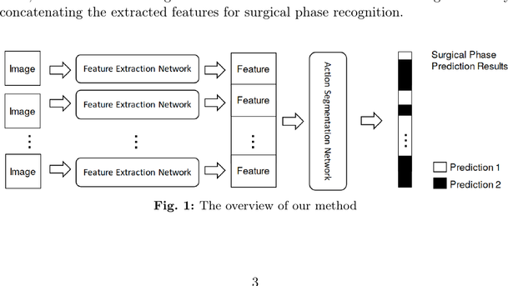
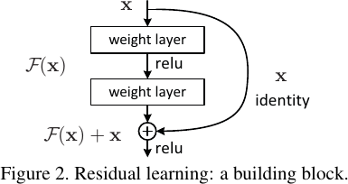
A CONTROLLED MODEL INTERFACE
The temporal models share one input–output interface
Video at 1 FPS
→
ResNet50
→
T × 2048 features
→
Temporal model
→
T × 7 logits
teammates
Frozen ImageNet ResNet50 · frames cached as JPEG
original
Frozen ImageNet ResNet50 · direct video decoding
finetuned
Layer 3 + layer 4 adapted to the laparoscopic domain
Controlled comparison: features change the spatial representation; architectures change temporal reasoning.
Figures: He et al., CVPR 2016, Fig. 2 · Zhang et al., IJCARS 2024, Fig. 1
Surgical Workflow Analysis
05
Notes:
Speaker: Alessio | Target: 0:40. Before comparing the models, we fix their interface. We sample one frame per second and ResNet50 converts each frame into a 2048-dimensional vector. For a video lasting T seconds, the temporal input is therefore T by 2048, and every architecture returns T by 7 logits: one score for each surgical phase at every second. Original, teammates, and finetuned change the ResNet representation; GRU, Transformer, MS-TCN, and SF-TMN change only how those vectors interact across time. This separation lets us compare temporal architectures on the same type of input.

Slide 6
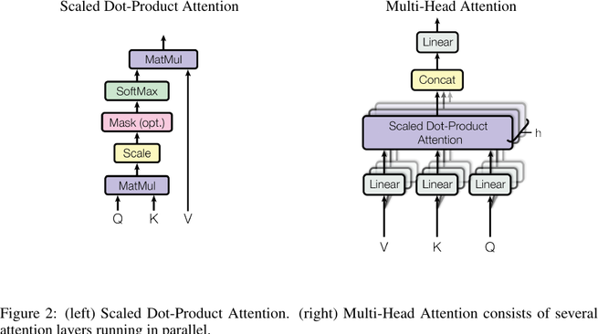
RECURRENT MEMORY VERSUS SELF-ATTENTION
Memory and attention see the surgical timeline differently
Shared recurrent projection: 2048 → 256 → LayerNorm → GELU → dropout
GRU
Past only. Two 256-unit layers compress preceding frames into one hidden state.
BiGRU
Past + future. 128 units per direction; 256 dimensions after concatenation.
MS-CBiGRU
Local + global. Dilated CNN spans 3 / 5 / 9 / 17 s before bidirectional recurrence.
3 layers · 8 heads
Positional encoding inside overlapping 64 s windows; overlap logits are averaged at inference.
Attention figure: Vaswani et al., NeurIPS 2017, Fig. 2 · Recurrent specifications: project notebooks
Surgical Workflow Analysis
06
Notes:
Speaker: Alessio | Target: 1:10. We use three recurrent variants and one windowed Transformer. Every recurrent model first projects 2048 features to 256 dimensions with LayerNorm, GELU, and dropout. The GRU then uses two unidirectional 256-unit layers, so each prediction summarizes only the past. The BiGRU reads both directions with 128 units per direction, giving past and future context without increasing the final 256-dimensional state. MS-CBiGRU first applies four parallel convolutions spanning 3, 5, 9, and 17 seconds, then uses the BiGRU; this combines local transition patterns with full-sequence memory. The Transformer instead adds positional encoding and uses three encoder layers with eight attention heads. It processes overlapping 64-second windows and averages logits in the overlap. Attention is flexible inside each window, but it has no true video-level memory, which helps explain its fragmented temporal predictions.

Slide 7
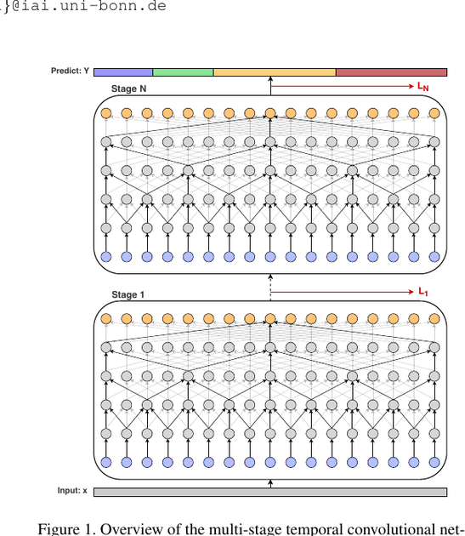
ARCHITECTURE DEEP DIVE
MS-TCN sees the whole video and refines it four times
Full sequence
2048 input channels are projected to 64 temporal channels.
2,047 / 4,095 s
Nominal context from 10 / 11 exponentially dilated layers.
4 supervised stages
Initial prediction followed by three probability refinements.
Phase + tools
Auxiliary instrument labels improve the shared representation.
Architecture figure: Abu Farha & Gall, CVPR 2019, Fig. 1
Surgical Workflow Analysis
07
Notes:
Speaker: Alessio | Target: 0:55. MS-TCN receives the complete video rather than short windows. A one-by-one convolution first projects the 2048 input channels to 64. Each stage then contains 10 or 11 residual layers whose dilation doubles from one up to 512 or 1024. This gives a nominal receptive field of 2047 or 4095 seconds per stage, enough to cover most operations. The model has four stages: the first predicts an initial phase sequence, while the next three consume only the preceding phase probabilities and learn to remove isolated errors and short fragments. Our multi-task version adds phase and instrument heads at every stage. Instruments provide auxiliary supervision to the shared representation, but only phase probabilities enter the next refinement stage.

Slide 8
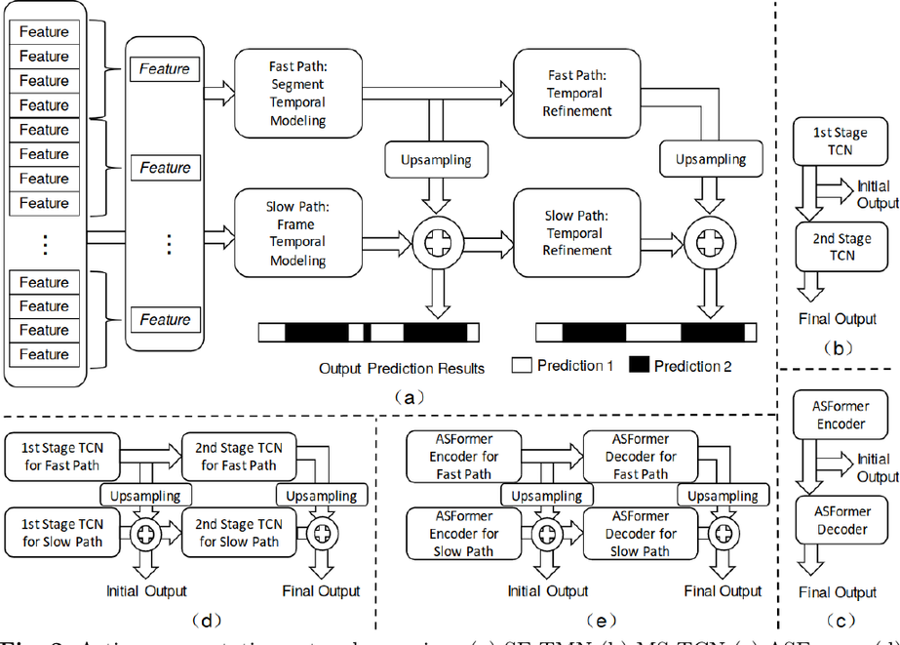
ARCHITECTURE DEEP DIVE
SF-TMN fuses frame and segment context
Slow · T positions
One prediction position per second preserves phase boundaries.
Fast · ≈ T / 32
32-second max pooling captures coarse workflow structure.
ASFormer blocks
Dilated convolution plus local attention at both resolutions.
Fusion + 3 refinements
Learned weights combine upsampled fast and slow features.
Architecture figure: Zhang et al., IJCARS 2024, Fig. 2
Surgical Workflow Analysis
08
Notes:
Speaker: Alessio | Target: 1:00. SF-TMN models the same video at two temporal resolutions. The slow path keeps all T one-second positions, preserving precise phase boundaries. The fast path max-pools non-overlapping groups of 32 seconds, reducing the sequence to roughly T divided by 32 and making long-range workflow structure cheaper to model. Both paths use ten ASFormer blocks with 64 channels. Each block combines an exponentially dilated convolution with local sliding-window attention, so it has a stronger segmentation bias than the windowed Transformer. Fast features are upsampled and fused with slow features using learned softmax weights. After the initial fusion, three decoder levels repeat this slow-fast refinement. This combination of precise boundaries, coarse context, and iterative correction explains why SF-TMN achieved the best segmental score.

Slide 9
TRAINING OBJECTIVE
The loss must protect rare phases without creating flicker
Weighted CE
Focal loss
Boundary-aware
Raises the cost of errors on under-represented phases.
Focuses learning on difficult and low-confidence frames.
Emphasizes a five-second neighborhood around transitions.
Total loss = phase loss + 0.30 × smoothing loss + 0.40 × instrument loss
Feature augmentation: Gaussian noise and random feature dropout.
Optimization: early stopping on validation mean segmental F1.
Source: Project report, Sections 3.3-3.4
Surgical Workflow Analysis
09
Notes:
Speaker: Marta | Target: 1:00. Training must address both class imbalance and temporal fragmentation. For Transformer and MS-TCN we compare weighted cross-entropy, focal loss, and a boundary-aware loss that emphasizes frames near transitions. MS-TCN also uses truncated temporal smoothing, which penalizes abrupt changes in adjacent log-probabilities. The multi-task model adds binary cross-entropy for tool presence with weight 0.40. Recurrent baselines use weighted cross-entropy plus lighter smoothing, while SF-TMN follows its reference setup with unweighted cross-entropy.

Slide 10
EVALUATION DISCIPLINE
Every choice is frozen before the test set is opened
01 · TRAIN
02 · VALIDATE
03 · TEST
Fit candidates
→
Select once
→
Evaluate once
Feature source × architecture × loss, seed 42.
Checkpoint, loss, raw vs Viterbi, tool threshold.
40 unseen videos; no further model selection.
Primary validation metric: mean of F1@10, F1@25, and F1@50.
Source: Project report, Sections 3.4.3 and 4.6
Surgical Workflow Analysis
10
Notes:
Speaker: Marta | Target: 1:00. We separate model selection from final evaluation. During development, each feature source, architecture, and loss is trained on the training set. Validation selects the best checkpoint, the loss family, and whether raw output or Viterbi post-processing is better. Only after all these choices are frozen is the 40-video test set instantiated and evaluated once. The instrument threshold is also selected only on validation. This protocol prevents tuning on the test results.

Slide 11
WHAT COUNTS AS A GOOD PREDICTION?
Temporal metrics expose errors that accuracy can hide
Frame-level view
Segment-level view
Accuracy, macro precision, macro recall, macro F1, and macro Jaccard.
Edit penalizes extra or missing phases. F1@k matches predicted and real intervals by temporal IoU.
Ground truth
F1@10
F1@25
F1@50
Prediction
lenient
balanced
strict
Viterbi is optional: validation keeps it only when it improves the temporal sequence.
Source: Project report, Chapter 4
Surgical Workflow Analysis
11
Notes:
Speaker: Marta | Target: 1:10. Accuracy and macro F1 measure frame classification, but they do not tell us whether the predicted sequence contains too many short, implausible segments. Edit score compares the ordered sequence of segments and strongly penalizes fragmentation. F1 at 10, 25, and 50 percent temporal overlap checks whether predicted phase intervals match real intervals at increasingly strict boundaries. We average those three F1 values as our primary metric. Viterbi decoding is selected only when validation shows that the learned phase-transition model improves temporal quality.

Slide 12
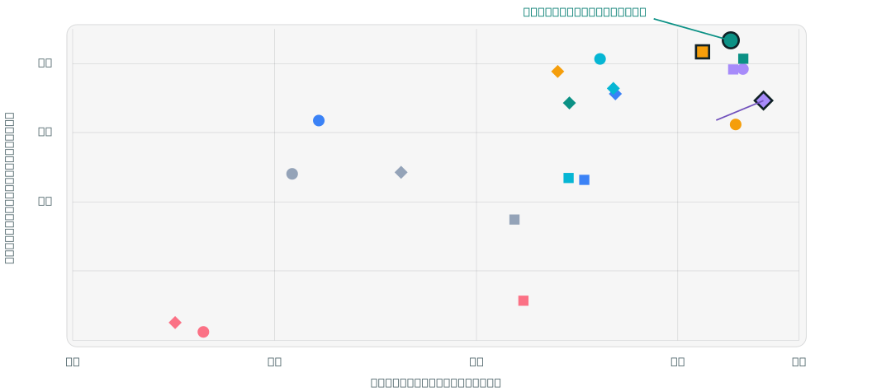
THE CENTRAL FINDING
The accuracy winner is not the temporal winner
GRU
BiGRU
MS-CBiGRU
Transformer
SF-TMN
MS-TCN-10L
MS-TCN-11L
○ original ■ finetuned ◆ teammates
Source: Project report, Tables 5.1-5.2
Surgical Workflow Analysis
12
Notes:
Speaker: Alessio | Target: 1:15. This plot contains all 21 architecture and feature-source combinations from the final report. The horizontal axis is frame accuracy and the vertical axis is mean segmental F1. A point can move right without moving up, so better frame classification does not guarantee better workflow reconstruction. The 11-layer multi-task MS-TCN with teammates features is furthest right at 92.12 percent accuracy, but its temporal score is 79.65. SF-TMN with original features is highest at 88.36 percent mean segmental F1, with 91.31 percent accuracy. For workflow reconstruction, that is the better trade-off.

Slide 13
PRIMARY METRIC RANKING
Full-sequence and multi-scale models dominate temporal quality
SF-TMN · original
88.36
MS-TCN-MT-10L · finetuned
86.69
SF-TMN · finetuned
85.70
MS-CBiGRU · original
85.67
MS-TCN-MT-11L · original
84.21
Transformer · finetuned
50.72
Mean segmental F1 (%) · higher is better
Source: Project report, Table 5.2
Surgical Workflow Analysis
13
Notes:
Speaker: Alessio | Target: 1:05. Looking at the top temporal configurations, SF-TMN with original features ranks first at 88.36 percent. The 10-layer multi-task MS-TCN with finetuned features follows at 86.69 percent, then SF-TMN finetuned at 85.70 and MS-CBiGRU original at 85.67. The temporal Transformer is substantially weaker, between 46 and 51 percent depending on features. Its 64-second windows classify many frames correctly, but they do not reconstruct the global procedure as reliably as full-sequence or multi-scale models.

Slide 14
WHAT THE AVERAGES CONCEAL
Feature source and depth interact with architecture
Change in mean segmental F1 when the multi-task MS-TCN moves from 10 to 11 layers:
original features
finetuned features
teammates features
+8.01
−2.54
−4.21
76.20 → 84.21
86.69 → 84.15
83.86 → 79.65
< 2.3 M
< 9 s
53.60%
parameters in every model
test inference for 40 videos
best instrument macro F1
Source: Project report, Sections 5.4-5.7
Surgical Workflow Analysis
14
Notes:
Speaker: Alessio | Target: 1:00. Feature quality is architecture-dependent. Finetuning helps the Transformer and gives the best macro F1 with the 11-layer MS-TCN, but original ImageNet features are best for SF-TMN and MS-CBiGRU. Depth is also not monotonic. Moving from 10 to 11 layers improves mean segmental F1 by 8.01 points on original features, but reduces it by 2.54 points on finetuned features and 4.21 points on teammates features. These are not pure causal ablations because validation selected different losses. Computationally, all models remain light, with test inference under nine seconds for 40 videos.

Slide 15
CONCLUSION
A surgical model is useful only when its sequence is clinically plausible.
Select SF-TMN original
Keep metrics aligned
Validate the next step
Best workflow reconstruction: 88.36% mean segmental F1.
Accuracy alone can reward fragmented predictions.
Multi-seed tests, controlled 10-vs-12 layers, and causal inference.
Questions
Source: Project report, Chapter 6
Surgical Workflow Analysis
15
Notes:
Speaker: Alessio | Target: 1:10. Our answer is task-dependent. If the goal is pure frame accuracy, the best choice is the 11-layer multi-task MS-TCN with teammates features. If the goal is coherent surgical workflow reconstruction, SF-TMN with original features is the stronger model, and that is our recommended configuration. The main limitations are one random seed, one hold-out split, offline future context, and a depth comparison that did not hold every training choice fixed. The next steps are multi-seed evaluation with paired per-video statistics, a controlled 10-versus-12-layer ablation, and a causal model for real-time assistance. The key lesson is that a surgical model is useful only when its sequence is clinically plausible.

Slide 16
BACKUP · COMPLETE REPORT RESULTS
Frame-level metrics on the test set
Feature
Model
Post
Acc.
Prec. M
Rec. M
F1 M
Jacc. M
original
GRU
Vit.
80.44
76.48
83.45
78.31
65.01
original
BiGRU
Vit.
81.10
73.30
86.77
77.16
63.76
original
MS-CBiGRU
Vit.
88.07
81.15
89.11
83.75
72.83
original
Transformer
Vit.
78.24
76.54
70.87
72.21
57.01
original
SF-TMN
raw
91.31
85.89
88.02
86.84
77.18
original
MS-TCN-MT-10L
raw
91.43
86.30
88.09
87.10
77.52
original
MS-TCN-MT-11L
Vit.
91.61
88.37
85.79
86.80
77.15
finetuned
GRU
Vit.
85.95
77.61
82.44
79.45
66.48
finetuned
BiGRU
Vit.
87.68
79.07
84.32
81.08
68.90
finetuned
MS-CBiGRU
Vit.
87.29
78.22
84.69
80.74
68.44
finetuned
Transformer
Vit.
86.17
82.70
80.49
80.68
68.02
finetuned
SF-TMN
Vit.
91.62
88.08
87.57
87.73
78.36
finetuned
MS-TCN-MT-10L
Vit.
90.61
84.00
89.92
86.37
76.31
finetuned
MS-TCN-MT-11L
Vit.
91.37
87.41
88.67
87.86
78.61
teammates
GRU
Vit.
83.14
78.34
81.93
79.48
66.58
teammates
BiGRU
Vit.
88.45
79.73
86.71
81.99
70.23
teammates
MS-CBiGRU
Vit.
88.40
79.90
87.66
82.80
71.37
teammates
Transformer
Vit.
77.54
72.03
74.54
71.35
56.36
teammates
SF-TMN
raw
87.31
79.74
78.46
78.89
66.61
teammates
MS-TCN-MT-10L
Vit.
87.02
84.87
83.09
83.62
72.18
teammates
MS-TCN-MT-11L
raw
92.12
87.16
87.70
87.34
77.98
Source: Project report, Table 5.1 · values in percent
Backup
16
Notes:
Backup slide; not included in the 15-minute timing. Use only if the committee asks for the complete frame-level comparison.

Slide 17
BACKUP · COMPLETE REPORT RESULTS
Temporal segmentation metrics on the test set
Feature
Model
Post
Edit
F1@10
F1@25
F1@50
Mean seg. F1
original
GRU
Vit.
65.06
72.99
71.55
62.64
69.06
original
BiGRU
Vit.
79.09
83.62
79.25
67.39
76.76
original
MS-CBiGRU
Vit.
85.71
89.67
87.67
79.67
85.67
original
Transformer
Vit.
44.63
52.49
47.41
38.73
46.21
original
SF-TMN
raw
86.69
91.40
91.06
82.63
88.36
original
MS-TCN-MT-10L
raw
77.22
79.35
78.17
71.09
76.20
original
MS-TCN-MT-11L
Vit.
81.78
87.17
86.51
78.95
84.21
finetuned
GRU
Vit.
57.21
67.08
64.36
55.94
62.46
finetuned
BiGRU
Vit.
64.36
72.68
70.79
61.10
68.19
finetuned
MS-CBiGRU
Vit.
63.85
72.41
71.06
61.91
68.46
finetuned
Transformer
Vit.
47.87
56.24
51.84
44.07
50.72
finetuned
SF-TMN
Vit.
85.73
89.11
87.79
80.20
85.70
finetuned
MS-TCN-MT-10L
Vit.
85.69
89.44
88.12
82.51
86.69
finetuned
MS-TCN-MT-11L
Vit.
84.26
86.97
86.32
79.15
84.15
teammates
GRU
Vit.
65.70
73.62
72.46
61.74
69.28
teammates
BiGRU
Vit.
79.71
84.98
83.39
73.48
80.62
teammates
MS-CBiGRU
Vit.
82.06
85.85
83.90
74.47
81.41
teammates
Transformer
Vit.
48.10
53.93
50.53
38.22
47.56
teammates
SF-TMN
raw
81.81
85.01
82.04
70.84
79.30
teammates
MS-TCN-MT-10L
Vit.
82.43
87.60
86.61
77.36
83.86
teammates
MS-TCN-MT-11L
raw
81.65
81.90
81.29
75.77
79.65
Source: Project report, Table 5.2 · values in percent
Backup
17
Notes:
Backup slide; not included in the 15-minute timing. Use only if the committee asks for the complete temporal segmentation comparison.

Slide 18
BACKUP · COMPLETE REPORT RESULTS
Auxiliary task, exploratory ablation, and efficiency
Instrument recognition
Computational efficiency
Feature / layer
Thr.
F1 M
F1 micro
Exact
Model
Params
Train min
VRAM MB
Test s
original / 10L
0.30
53.60
70.09
32.13
GRU
1,316,359
2.14-3.64
205-206
2.26-2.32
original / 11L
0.30
49.05
69.90
31.49
BiGRU
1,119,751
0.47-0.82
252
0.71-0.75
finetuned / 10L
0.30
31.20
64.05
23.91
MS-CBiGRU
1,382,919
0.51-0.92
283
0.68-0.75
finetuned / 11L
0.40
48.16
71.22
34.34
Transformer
2,173,959
6.99-16.72
144
0.96-1.04
teammates / 10L
0.30
50.02
69.33
31.12
SF-TMN
2,259,932
17.25-29.14
336
5.02-8.46
teammates / 11L
0.30
50.16
69.87
31.67
MS-TCN-MT-10L
796,792
0.78-2.10
158-159
0.67-2.18
MS-TCN-MT-11L
862,840
1.19-1.89
166
0.69-2.27
Single-task MS-TCN exploratory ablation
Loss
Acc.
F1 M
Jacc. M
Edit
Weighted CE
91.32
87.81
78.49
79.13
Interpretation
Focal γ=1
91.43
87.36
77.80
82.41
The instrument task remains imbalanced; the single-task loss comparison is exploratory because standardized segmental metrics were not exported.
Boundary-aware
91.49
87.00
77.31
81.15
Source: Project report, Tables 5.3-5.5 · values in percent unless stated
Backup
18
Notes:
Backup slide; not included in the 15-minute timing. Contains the remaining quantitative results from Tables 5.3, 5.4, and 5.5.

